Slide 1

Diabetes Prediction Using Machine Learning
A complete ML lifecycle implementation for early detection and intervention
By Anmol Sharma

Slide 2

The Diabetes Challenge: Why Prediction Matters
537M+ People Affected
Critical Complications
Worldwide diabetes prevalence according to International Diabetes Federation 2021
Kidney failure, blindness, heart disease—all preventable with early detection
AI-Powered Solution
Machine learning enables scalable, accurate predictive tools for timely intervention

Slide 3
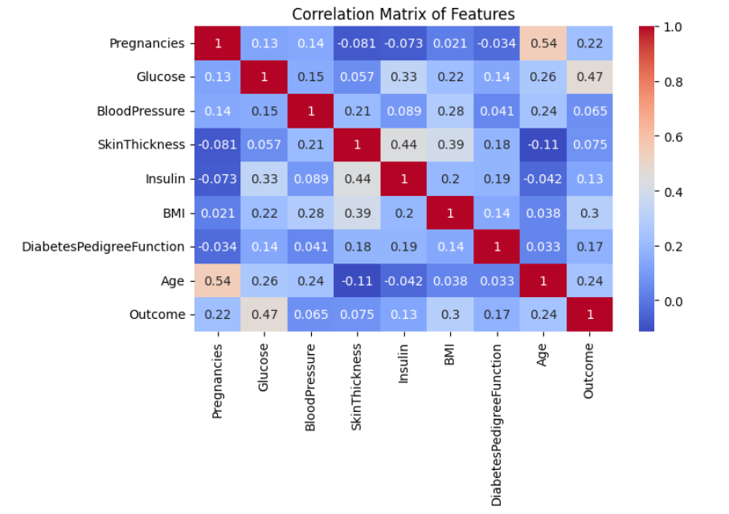
Dataset & Exploratory Data Analysis
Data Foundation
Built on the renowned Pima Indian Diabetes Dataset, enhanced with additional clinical data for comprehensive analysis.
Key Features Analyzed:
Glucose levels (primary indicator)
Body Mass Index (BMI)
Blood pressure readings
Age demographics
Insulin measurements

Slide 4
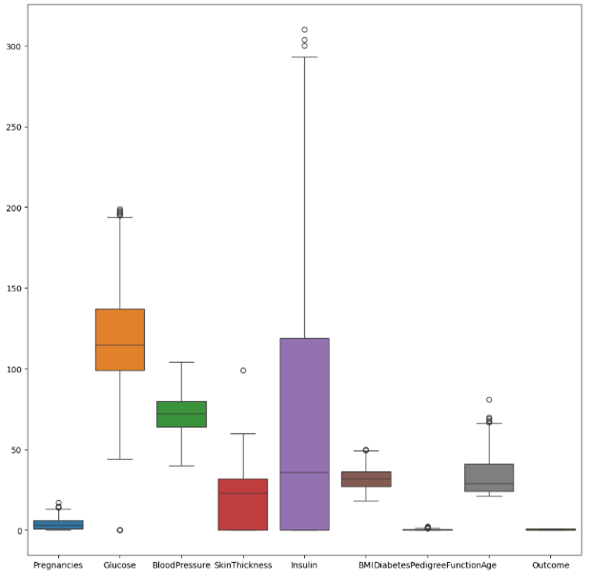
Dataset & Exploratory Data Analysis
Data Preparation
Cleaning & Balancing:
Data contains 0 values for columns such as Insulin
BMI , Blood Pressure ,etc. which is not possible. (Imputed Them with Median values as there are
Outliers.)
Removed outliers in Insulin Feature with
statistical method.
Addressed class imbalance with SMOTE Oversampling.
Visualized feature correlations using heatmaps
Scaled features using StandardScaler

Slide 5






Machine Learning Lifecycle Steps Applied
Data Collection & Preprocessing
Gathered clinical data, cleaned inconsistencies, normalized features
Libraries Used :-
numpy : For Numerical Use
pandas : For Dataframe Manipulation
seaborn and matplotlib : For Visualization
sklearn : For Machine Learning
imblearn : For oversample imbalanced dataset
joblib : For model saving and loading
streamlit : For UI creation
mlflow : For model logging and evaluation
Feature Engineering & Selection
Applied mutual information method to identify most predictive features
Model Selection & Training
Trained multiple algorithms to find optimal performance
Hyperparameter Tuning
Fine-tuned models using grid search and cross-validation
Model Evaluation & Validation
Assessed performance using comprehensive metrics
Deployment Planning
Prepared models for real-world application integration

Slide 6




Models Explored & Why
Three classification algorithms were evaluated to identify the optimal approach for diabetes prediction:
Logistic Regression
Support Vector Machine
Probabilistic approach offering interpretability with risk scores
Highly effective in high-dimensional feature spaces with complex boundaries
Random Forest
Ensemble method combining multiple trees for improved robustness and accuracy

Slide 7


Model Training & Evaluation
Training Approach
74.83%
Data Split:
80% Training set
Random Forest Accuracy
20% Testing set
Best performing model across all evaluation metrics
5-fold cross-validation
Evaluation Metrics:
0.6481
Accuracy
Precision
F1-Score
F1-Score
Recall
Balanced precision-recall performance
0.6666
Recall
Strong discriminative ability between classes
Critical Healthcare Focus: Confusion matrix analysis prioritized minimizing false negatives—missing a diabetic patient is far more costly than a false positive.

Slide 8
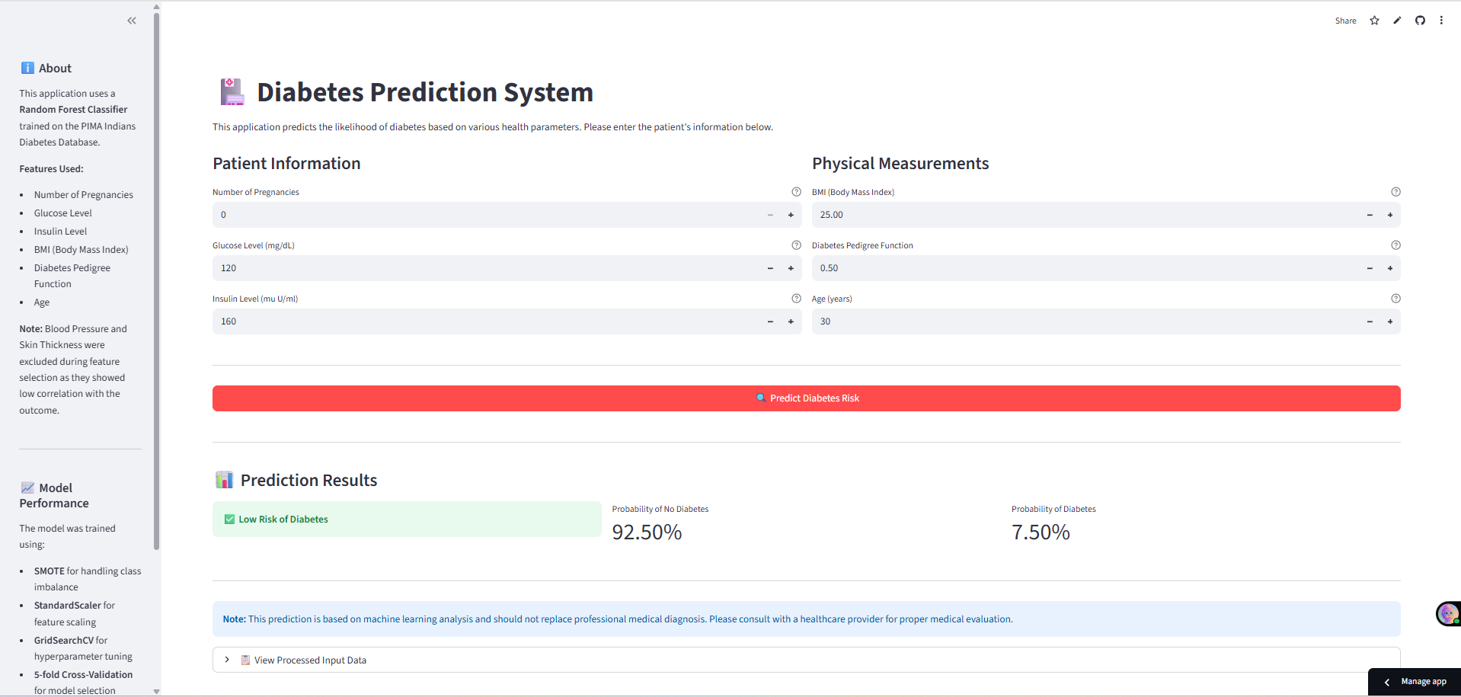
Deployment : Streamlit
Link : - Diebetes Predictor App

Slide 9
Challenges & Key Learnings
Imbalanced Data
Feature Selection Impact
Class imbalance posed significant challenges initially. SMOTE and technique proved critical for generating reliable synthetic data across both diabetic and non-diabetic cases.
Careful feature engineering using mutual information dramatically improved model generalization. Not all collected features contributed equally—identifying the right subset was transformative.
Scale and Oversample after splitting data
Always use same scaling on input data
Always use the Scaling, Oversampling and other techniques on splitted training data to avoid the data overflow in the test set
Use the same scaler on the input data also which was used during training, otherwise the model can face Accuracy Paradox where the model always classifies same class whether the metrics is good.

Slide 10

Thank You!

